Slide 1
Course Title: Artificial Intelligence and Expert System
Course Code: CSC4226
Dept. of Computer Science
Faculty of Science and Technology
Lecture No: | Two (2) | Week No: | Two (2) | Semester: | Spribg 2025-26
Lecturer: | Prof. Dr. Firoz Ahmed fahmed@aiub.edu

Slide 2
Lecture Outline
Intelligent Agent:
  Agent and Environment
  Types of Agents, Learning agent Concept of Rationality
  Components of Agent Program.
  Solving problem by searching

Slide 3
Agent
In artificial intelligence, an agent is a computer program or system that is designed to perceive its environment, make decisions and take actions to achieve a specific goal or set of goals
The agent operates autonomously, meaning it is not directly controlled by a human operator.
Examples:
  Human → eyes (sensors), hands/legs (actuators)
  Robot → cameras, motors
  Software agent → keyboard input, screen output
These are the main four rules all AI agents must adhere to:
  Rule 1: An AI agent must be able to perceive the environment.
  Rule 2: The environmental observations must be used to make decisions.
  Rule 3: The decisions should result in action.
  Rule 4: The action taken by the AI agent must be a rational. Rational actions are actions that maximize performance and yield the best positive outcome

Slide 4
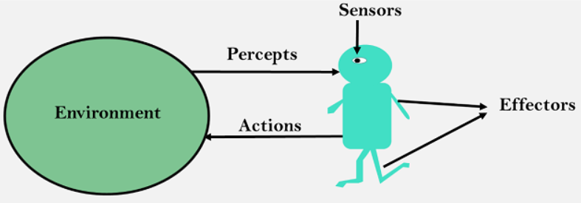
Agent
Sensor
  Sensor is a device which detects the change in the environment and sends the information to other electronic devices
  An agent observes its environment through sensors.
Actuators
  Actuators are the component of machines that converts energy into motion
  The actuators are only responsible for moving and controlling a system
  An actuator can be an electric motor, gears, rails, etc.
Effectors
  Effectors are the devices which affect the environment
  Effectors can be legs, wheels, arms, fingers, wings, fins, and display screen.

Slide 5
Agent
Environment
  The environment is everything external to the agent with which it interacts.
  Examples:
    Chessboard for a chess-playing agent
    Road, traffic, and pedestrians for a self-driving car

Slide 6
Agent
An agent can be
  Human-Agent
    A human agent has eyes, ears, and other organs which work for sensors and hand, legs, vocal tract work for actuators.
  Robotic Agent
    A robotic agent can have cameras, infrared range finder, NLP for sensors and various motors for actuators.
  Software Agent
    Software agent can have keystrokes, file contents as sensory input and act on those inputs and display output on the screen.
  Hence the world around us is full of agents such as thermostat, cellphone, camera, and even we are also agents.
  Before moving forward, we should first know about sensors, effectors, and actuators.

Slide 7
Agent
An intelligent agent is an autonomous entity which act upon an environment using sensors and actuators for achieving goals
An intelligent agent may learn from the environment to achieve their goals
A thermostat is an example of an intelligent agent.

Slide 8
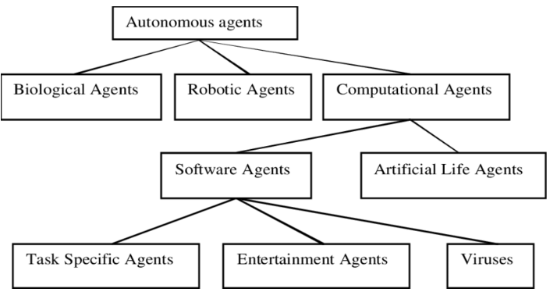
Taxonomy of Autonomous Agent

Slide 9
Agent vs Programs
Size - an agent is usually smaller than a program.
Purpose - an agent has a specific purpose while programs are multi-functional.
Persistence - an agent's life span is not entirely dependent on a user launching and quitting it.
Autonomy - an agent doesn't need the user's input to function.

Slide 10
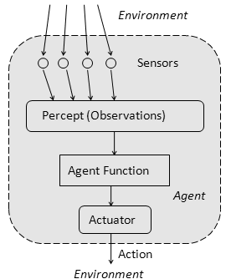
Agent Function
The agent function is a mathematical function that maps a sequence of perceptions into action.
The function is implemented as the agent program.
The part of the agent taking an action is called an actuator.
environment -> sensors -> agent function -> actuators -> environment

Slide 11
Agent Program
An agent program is an implementation of an agent function
An agent function is a map from the percept sequence(history of all that an agent has perceived to date) to an action.
Agent = Architecture + Agent Program

Slide 12
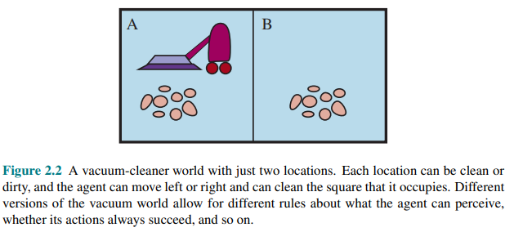
VACUUM CLEANING AGENT

Slide 13
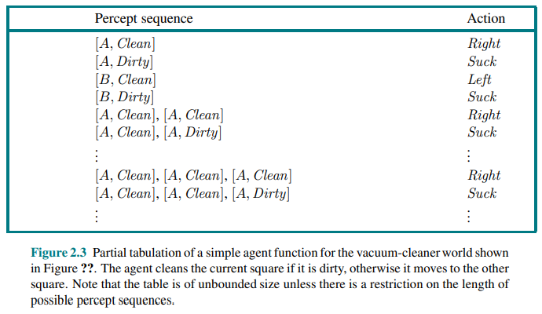
VACUUM CLEANING AGENT

Slide 14
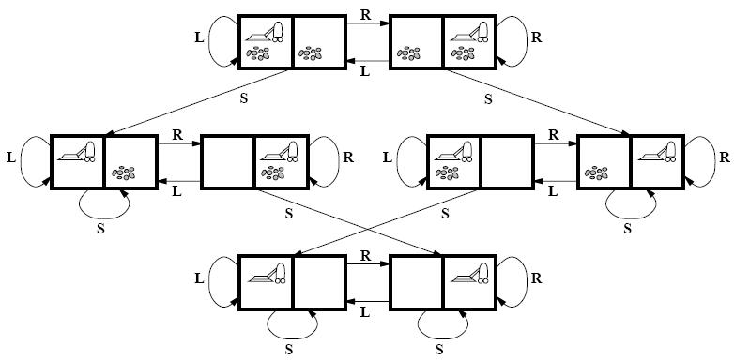
VACUUM CLEANING AGENT

Slide 15
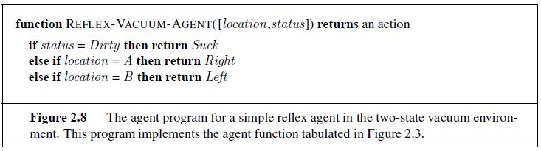
VACUUM CLEANING AGENT

Slide 16
GOOD BEHAVIOR:
THE CONCEPT OF RATIONALITY
Rational Agent: A rational agent is one that does the right thing
  What is the right thing?
    A sequence of actions causes the environment to go through a sequence of states
    If the sequence is desirable, then the agent has performed well
Rationality at any given point depends on four things:
  The performance measure that defines the criterion for success.
  The agent’s prior knowledge of the environment
  The actions that the agent can perform
  The agent’s percept sequence till date
Performance measure: a set of criteria/test bed for the success of the agent's behavior.
The performance measures should be based on the desired effect of the agent on the environment.

Slide 17
PEAS
PEAS is a representation system for AI agents which caters to measuring Performance with respect to Environment, Sensors, and actuators
To design an agent, we must know our task environment
PEAS system helps specify the task environment
PEAS is a short form for Performance, Environment, Actuators, and Sensors. Identifying PEAS can help write optimum algorithms for AI

Slide 18
PEAS
Sensors
  Sensors help agents perceive their environment by giving them a complete set of Inputs
  The action of agents depends on the past history and the current input set
  Examples of sensors include cameras, GPS, odometers, various sensing tools, etc.
Actuators
  Actuators help agents operate in the environment
  Actuators include display boards, object-picking arms, track-changing mechanisms, etc
  Actions performed by agents can bring change to the environment as well.
Environment
  The surrounding of the agent at a particular instant in which the agent works is called the environment
  It can be static or dynamic based on the motion of the agent
  A small change in the environment will also change the required sensors and actions of the Agent.
Performance measure
  Performance measure is the unit to define the agent’s success or accuracy in achieving its set goals.

Slide 19
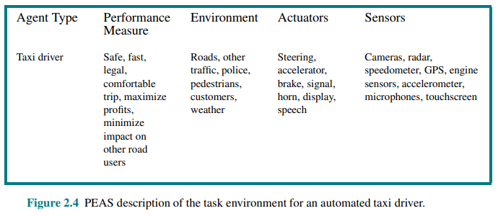
SPECIFYING THE TASK ENVIRONMENT:
PEAS DESCRIPTION

Slide 20
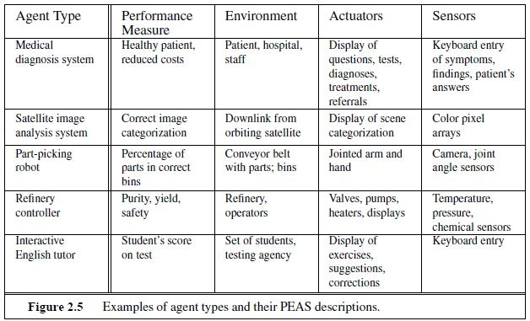
PEAS Example

Slide 21
Properties of Task Environments
Fully Observable vs Partially Observable
  When an agent sensor is capable to sense or access the complete state of an agent at each point in time, it is said to be a fully observable environment else it is partially observable.
  An environment is called unobservable when the agent has no sensors in all environments.
  Examples:
    Chess – the board is fully observable, and so are the opponent’s moves.
    Driving – the environment is partially observable because what’s around the corner is not known

Slide 22
Properties of Task Environments
Deterministic vs Stochastic
  When a uniqueness in the agent’s current state completely determines the next state of the agent, the environment is said to be deterministic.
  The stochastic environment is random in nature which is not unique and cannot be completely determined by the agent.
  Examples
    Chess – there would be only a few possible moves for a coin at the current state and these moves can be determined.
    Self-Driving Cars- the actions of a self-driving car are not unique, it varies time to time.

Slide 23
Properties of Task Environments
Competitive vs Collaborative
  An agent is said to be in a competitive environment when it competes against another agent to optimize the output.
  The game of chess is competitive as the agents compete with each other to win the game which is the output.
  An agent is said to be in a collaborative environment when multiple agents cooperate to produce the desired output.
  When multiple self-driving cars are found on the roads, they cooperate with each other to avoid collisions and reach their destination which is the output desired.

Slide 24
Properties of Task Environments
Single-agent vs Multi-agent
  An environment consisting of only one agent is said to be a single-agent environment.
  A person left alone in a maze is an example of the single-agent system.
  An environment involving more than one agent is a multi-agent environment.
  The game of football is multi-agent as it involves 11 players in each team.

Slide 25
Properties of Task Environments
Dynamic vs Static
  An environment that keeps constantly changing itself when the agent is up with some action is said to be dynamic.
  A roller coaster ride is dynamic as it is set in motion and the environment keeps changing every instant.
  An idle environment with no change in its state is called a static environment.
  An empty house is static as there’s no change in the surroundings when an agent enters

Slide 26
Properties of Task Environments
Episodic vs Sequential:
  In an episodic environment, there is a series of one-shot actions, and only the current percept is required for the action.
  However, in Sequential environment, an agent requires memory of past actions to determine the next best actions.

Slide 27
Properties of Task Environments
Discrete vs Continuous
  If an environment consists of a finite number of actions that can be deliberated in the environment to obtain the output, it is said to be a discrete environment.
  The game of chess is discrete as it has only a finite number of moves. The number of moves might vary with every game, but still, it’s finite.
  The environment in which the actions are performed cannot be numbered i.e. is not discrete, is said to be continuous.
  Self-driving cars are an example of continuous environments as their actions are driving, parking, etc. which cannot be numbered

Slide 28
Structure of an AI agent
The task of AI is to design an agent program which implements the agent function
The structure of an intelligent agent is a combination of architecture and agent program
It can be viewed as:
  Agent = Architecture + Agent program
Obviously, the program we choose has to be one that is appropriate for the architecture
  If the program is going to recommend actions like Walk, the architecture had better have legs
  The architecture might be just an ordinary PC, or it might be a robotic car with several onboard computers, cameras, and other sensors.

Slide 29
Structure of an AI agent
Following are the main three terms involved in the structure of an AI agent:
  Architecture
    Architecture is machinery that an AI agent executes on.
  Agent Function
    Agent function is used to map a percept to an action.
  Agent program
    Agent program is an implementation of agent function
    An agent program executes on the physical architecture to produce function f.

Slide 30
Table Driven Agents: Agent Example
Table-driven agents
  It consists in a lookup table of actions to be taken for every possible state of the environment.
If the environment has n variables, each with t possible states, then the table size is t^{n}.
Only works for a small number of possible states for the environment.

Slide 31
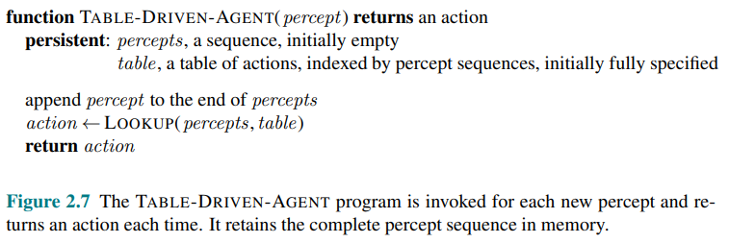
Table Driven Agents

Slide 32
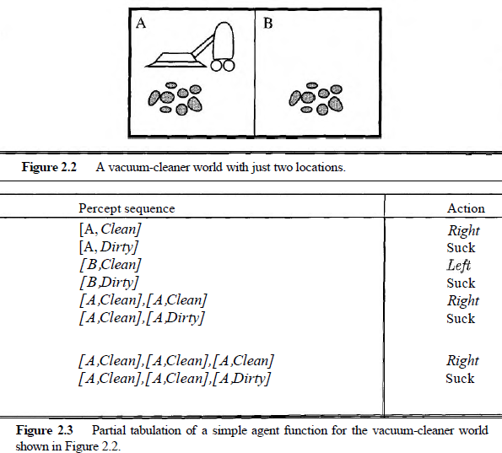
Vacuum Cleaning Agents: Table Driven

Slide 33
Limitation of Table Driven Agent
No physical agent in this universe will have the space to store the table,
No agent could ever learn all the right table entries from its experience, and
Even if the environment is simple enough to yield a feasible table size, the designer still has no guidance about how to fill in the table entries

Slide 34
Types of AI Agents
Agents are classified based on how they make decisions and use information from the environment.
Simple reflex agents
Model-based reflex agents
Goal-based agents
Utility-based agents
Learning Agents

Slide 35
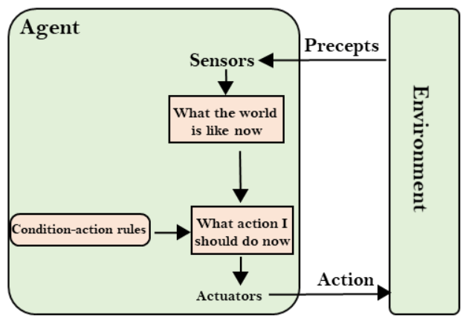
Simple Reflex Agent

Slide 36
Simple Reflex Agent
These agents take decisions on the basis of the current percepts and ignore the rest of the percept history.
These agents only succeed in the fully observable environment.
It does not consider any part of percepts history during their decision and action process.
It works on Condition-action rule, which means it maps the current state to action
Example:
A room thermostat:
If temperature < 20°C → Turn heater ON
If temperature ≥ 20°C → Turn heater OFF
It reacts immediately based on the current reading.

Slide 37
Model Based Agent
The Model-based agent can work in a partially observable environment, and track the situation.
A model-based agent has two important factors:
      Model: It is knowledge about "how things happen in the world," so it is called a Model-based agent.
      Internal State: It is a representation of the current state based on percept history.
These agents have the model, "which is knowledge of the world" and based on the model they perform actions.
    Updating the agent state requires information about:
      How the world evolves
      How the agent's action affects the world.

Slide 38
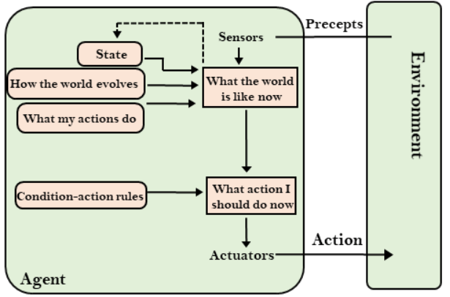
Model Based Agent
    Example:
A robot vacuum cleaner:
Remembers which areas have already been cleaned (internal model).
If a new obstacle appears, it updates its model and plans a new route.

Slide 39
Goal Based Agent
Goal-based agents expand the capabilities of the model-based agent by having the "goal" information.
Goal-based agents are AI agents that use information from their environment to achieve specific goals
They employ search algorithms to find the most efficient path towards their objectives within a given environment.
They can be used in various applications like robotics, computer vision, and natural language processing
Unlike basic models, a goal-based agent can determine the optimal course of decision-making and action-taking processes depending on its desired outcome or goal
Example: A chess-playing AI whose goal is winning the game

Slide 40
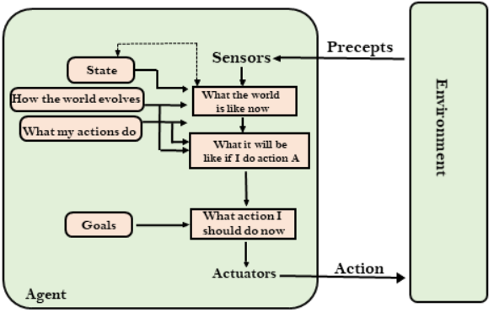
Goal Based Agent

Slide 41
Utility Based Agent
Utility agent have their end uses as their building blocks and is used when best action and decision needs to be taken from multiple alternatives.
It is an improvement over goal based agent
  As it not only involves the goal but also the way the goal can be achieved such that the goal can be achieved in a quicker, safer, cheaper way (best possible way)
It takes the agent happiness into account and gives an idea of how happy the agent is because of the utility and hence, the action with maximum utility is considered
Example:
A self-driving car uses a utility-based system:
  Utility considers safety, speed, comfort, and fuel efficiency.
  The car chooses actions (like braking, overtaking) that maximize overall driving utility

Slide 42
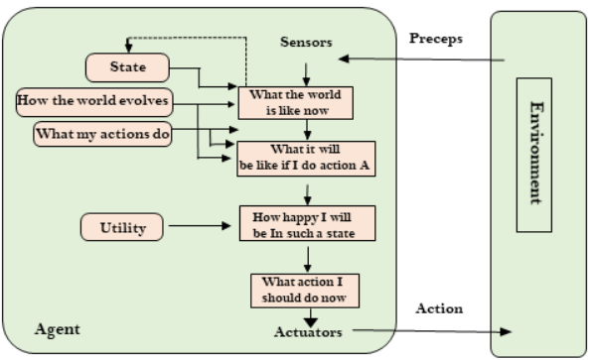
Utility Based Agent

Slide 43
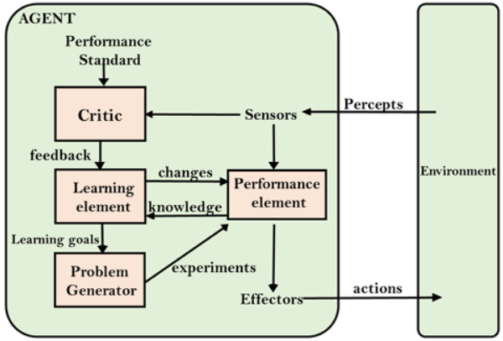
Learning Based Agent
An AI learning agent is a software agent that can learn from past experiences and improve its performance

Slide 44
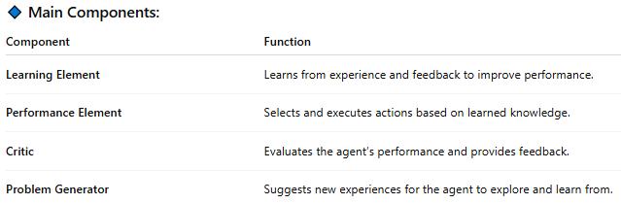
Learning Based Agent
Example:
A chess-playing AI (like AlphaZero):
Plays games and learns from wins and losses.
Improves its strategies over time.
Eventually plays better than the initial programmed version

Slide 45
Exercise
What is the difference between Goal based agent and Utility based agent?
Describe the working procedure of a Goal Based Agent and draw its schematic diagram.
Develop PEAS description of the task environment for a Candy Sorting Robot that can sort candies to the appropriate jars
Explain the “Optimality” properties of the depth-first search algorithm.

Slide 46
Exercise
Consider the 8-queens problem. In a game of chess a queen can attack another one if they are placed on the same row, column, or diagonal. You have to place 8 queens on an empty 8x8 chessboard so that no queen can attack each other. Suppose at the initial state, the queens are already placed on the chessboard so that each column has exactly one queen. As action, a queen can be moved anywhere in its same column. Answer the following:
How many successors does a state have? Explain your calculation.
What is the size of the state-space? Explain your calculation.

